Slide 2
Midsem-Presentation
Of
Test Automation
On
Testing a website – “www.internshala.com”
Under guidance of
Dr. Nitika Goenka
Assistant Professor
Department of Cybernetics,
School of Computer Science Engineering
UNIVERSITY OF PETROLEUM AND ENERGY STUDIES

Slide 3
Submitted by-
Aishwarya Sharma | R171217005 | 500061354
Ishika Singh | R171217024 | 500062316
Garishma Virk | R171217017 | 500060134

Slide 4
Overview
Software Testing- Automation testing is a technique of testing and comparing the actual outcome with the expected outcome. This is achieved by writing test scripts or using any automation testing tool like TestNG or selenium. The automation of repeated task is done so the time is not wasted in ding them manually.
Function login()- The function navigates to Google.com and searches for Internshala. The code next navigates to the website of Internshala and opts for login option. The email and the password of the user are entered. For exception of a newsletter popup, try catch block is added to select the “no- thanks option.” The page is then scrolled down to the bottom using JavaScript executor.
Function contact_us()- The function navigates to contact page of internshala. Here comes the use of data provider, after opening the contact page on official website, The internshala page is opened on Instagram, twitter, YouTube and linkdLN.
Function close_tabs()- Using data provider the tabs of Instagram, YouTube etc are closed. Using ArrayList list of all the window handles is gathered. The tabs are now switched and we switch the original previous tab.

Slide 5
Overview
Function goTointernships()- We click on the internship superscript, to navigate to the home page of the internshala.
Function selectCategory()-The filter is added here, we need the internship related to computer science category. So computer science is typed here.
Function searchAndApply() –The desired internship is now searched and opened. Now there can be two cases either the internship we have searched for is already applied by us or we still have to apply.
This is handled by try catch block, if the internship is already applied then we navigate back to the home page otherwise the internship is proceeded to application.
Function submit()- The applied internship is now submitted, cover letter and other required formalities are filled and the internship is finally applied to. The written formalities for different internship is different, therefore try and catch block is used for this problem.
Function returnback()- we return back to internship home page, by clicking on the popup.
Function logout()- We logout from the website.

Slide 6
Source code
import org.testng.annotations.Test;
import org.testng.annotations.DataProvider;
import org.testng.annotations.BeforeTest;
import java.util.ArrayList;
import org.openqa.selenium.By;
import org.openqa.selenium.JavascriptExecutor;
import org.openqa.selenium.Keys;
import org.openqa.selenium.WebDriver;
import org.openqa.selenium.WebElement;
import org.openqa.selenium.chrome.ChromeDriver;
import org.openqa.selenium.support.ui.ExpectedConditions;
import org.openqa.selenium.support.ui.WebDriverWait;
import org.testng.annotations.AfterTest;
public class internshalaTest {
public static WebDriver driver;
JavascriptExecutor js = (JavascriptExecutor) driver;
//*************************************login**********************************************//
@Test(priority=1)
public void login() {
WebElement search_bar = driver.findElement(By.name("q"));
search_bar.sendKeys("internshala");
search_bar.sendKeys(Keys.ENTER);

Slide 7
Source Code
//************************************go to internships************************************//
@Test(priority=4)
public void goTointernships() throws InterruptedException {
WebDriverWait wait1 = new WebDriverWait(driver,60);
wait1.until(ExpectedConditions.visibilityOfElementLocated(By.id("internships_new_superscript")));
WebElement internships = driver.findElement(By.id("internships_new_superscript"));
internships.click();
}
//*************************************select category*************************************//
@Test(priority=5)
public void selectCategory() throws InterruptedException {
WebDriverWait wait3 = new WebDriverWait(driver,60);
wait3.until(ExpectedConditions.visibilityOfElementLocated(By.cssSelector("input.chosen-search-input.default")));
WebElement category = driver.findElement(By.cssSelector("input.chosen-search-input.default"));
category.click();
category.sendKeys("Computer Science");
category.sendKeys(Keys.ENTER);
}//**************************************search and apply*********************************//
@Test(priority=6)
public void searchAndApply() throws InterruptedException {
WebDriverWait wait4 = new WebDriverWait(driver,60); wait4.until(ExpectedConditions.visibilityOfElementLocated(By.xpath("//*[@id=\"individual_internship_895975\"]/div[1]/div[1]/div[1]/h4[1]/a")));
WebElement intern_select = driver.findElement(By.xpath("//*[@id=\"individual_internship_895975\"]/div[1]/div[1]/div[1]/h4[1]/a"));
intern_select.click();
try {
//if not already applied to the internship
WebElement apply_now = driver.findElement(By.id("search_button"));
apply_now.click();

Slide 8
Source Code
WebElement proceed = driver.findElement(By.cssSelector("button.btn.btn-primary.education_incomplete"));
proceed.click();
}
catch(Exception e)
{ //if applied then go back to internships page
WebElement internships = driver.findElement(By.id("internships_new_superscript"));
internships.click();
}
}
//**********************************submit form******************************************************//
@Test(priority=7)
public void submit() throws InterruptedException {
try {
WebDriverWait wait4 = new WebDriverWait(driver,60);
wait4.until(ExpectedConditions.visibilityOfElementLocated(By.id("cover_letter")));
WebElement cover_letter = driver.findElement(By.id("cover_letter"));
cover_letter.sendKeys("I am an enthusiastic coder and ready to take challanges and learn new things.");
WebElement text2 = driver.findElement(By.id("text_1081226"));
text2.sendKeys("Yes");
try{
WebElement text3 = driver.findElement(By.id("text_1081249"));
text3.click();
text3.sendKeys("xyz1");
WebElement text4 = driver.findElement(By.id("text_1081250"));
text4.click();
text4.sendKeys("xyz2");
}

Slide 9
Source Code
catch(Exception e)
{}
WebElement submit = driver.findElement(By.name("submit"));
submit.click();
}
catch(Exception e)
{}
}
//***************************Return back to internships page**********************************//
@Test(priority=8)
public void returnBack() throws InterruptedException {
try{
WebDriverWait wait6 = new WebDriverWait(driver,60);
wait6.until(ExpectedConditions.visibilityOfElementLocated(By.id("backToInternshipsCta")));
WebElement back = driver.findElement(By.id("backToInternshipsCta"));
back.click();
}
catch(Exception e)
{}
}//*****************************************logout***********************************************//
@Test(priority=9)
public void logout() throws InterruptedException {
WebElement account = driver.findElement(By.cssSelector("div.profile_icon_right"));
account.click();
WebElement more = driver.findElement(By.cssSelector("span.glyphicon.pull-right.glyphicon-menu-down") );
more.click();
WebElement logout = driver.findElement(By.linkText("Logout"));
logout.click();
}

Slide 10
Source Code
//*********************************data providers**********************************************//
@DataProvider(name = "dataprovider")
public Object[][] dp() {
return new Object[][] {
new Object[] { "i.is-icon-instagram" }, //css-selector values
new Object[] { "i.is-icon-twitter"},
new Object[] { "i.is-icon-youtube"},
new Object[] { "i.is-icon-linkedin"},
};
}
//************************************before test************************************************//
@BeforeTest
public void beforeTest() {
System.setProperty("webdriver.chrome.driver", "C:\\Users\\500062316\\Desktop\\Softwares\\chromedriver.exe");
driver = new ChromeDriver();
driver.manage().window().maximize();
driver.navigate().to("http://www.google.com/");
driver.manage().window().maximize();
}
//**********************************after test(quit window)************************************************//
@AfterTest
public void afterTest() {
driver.quit();
}
}

Slide 11
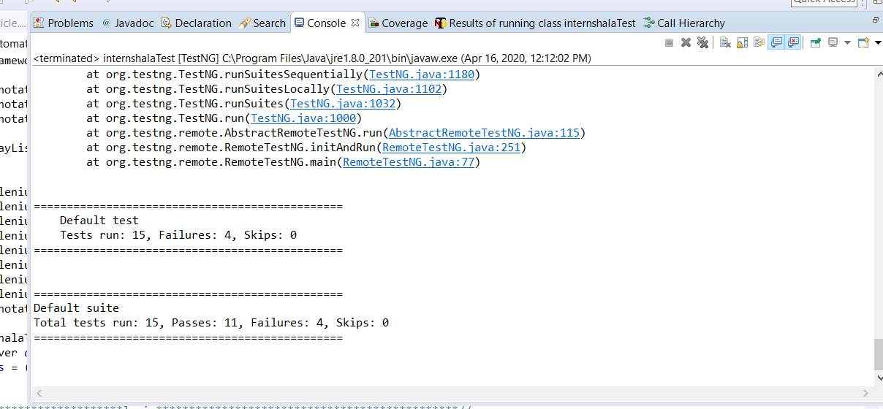
Result

Slide 12
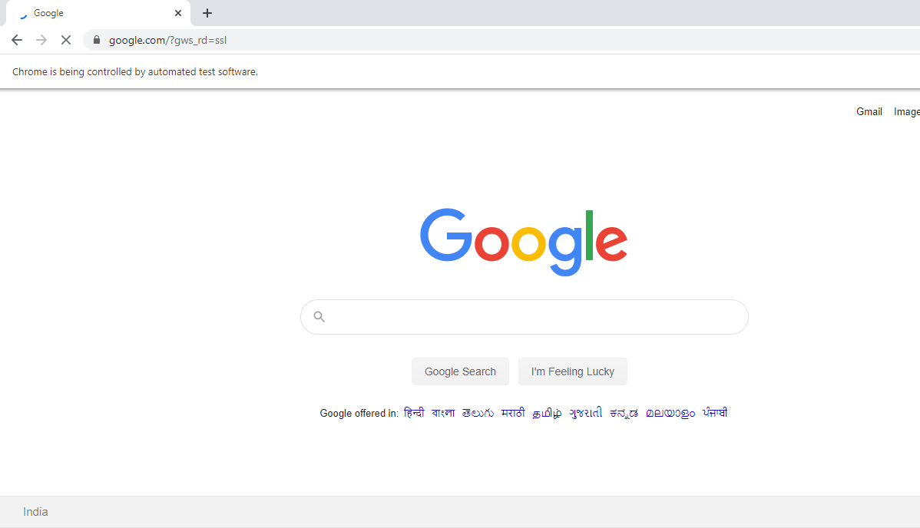
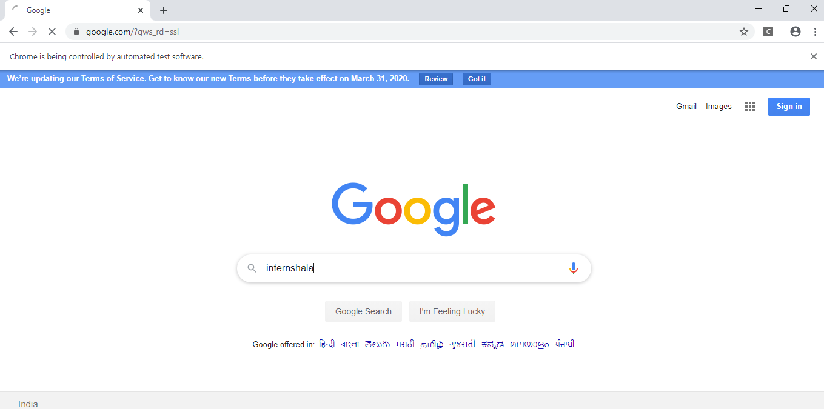
Screenshots

Slide 13
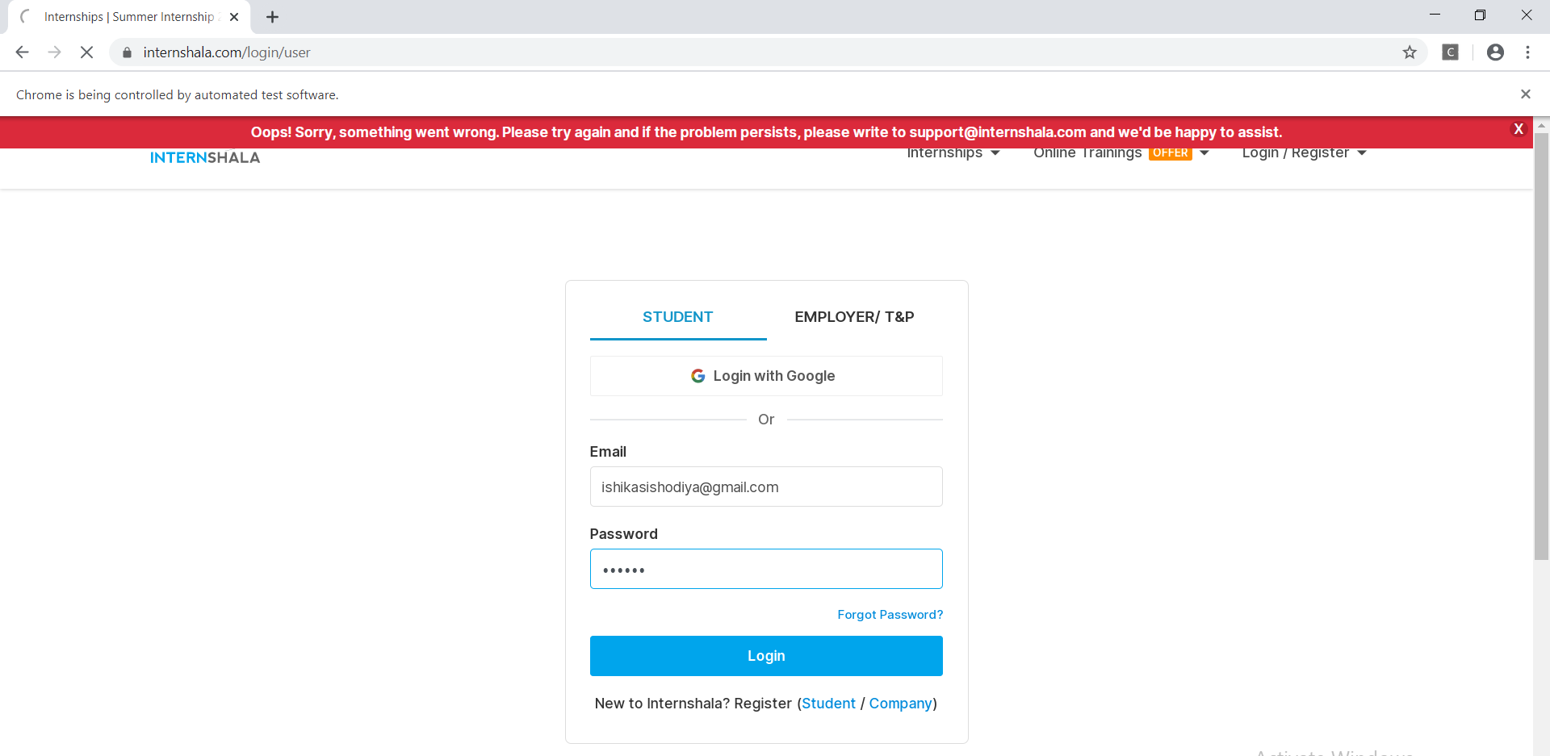
Screenshots

Slide 14
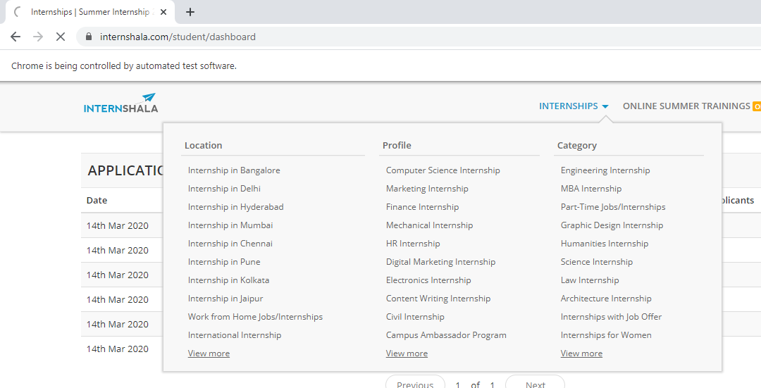
Screenshots

Slide 15
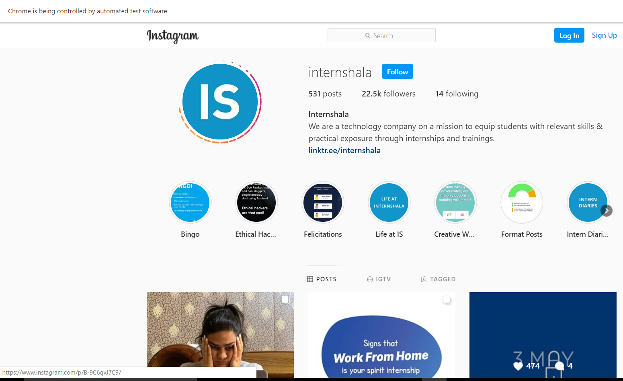
Screenshots

Slide 16
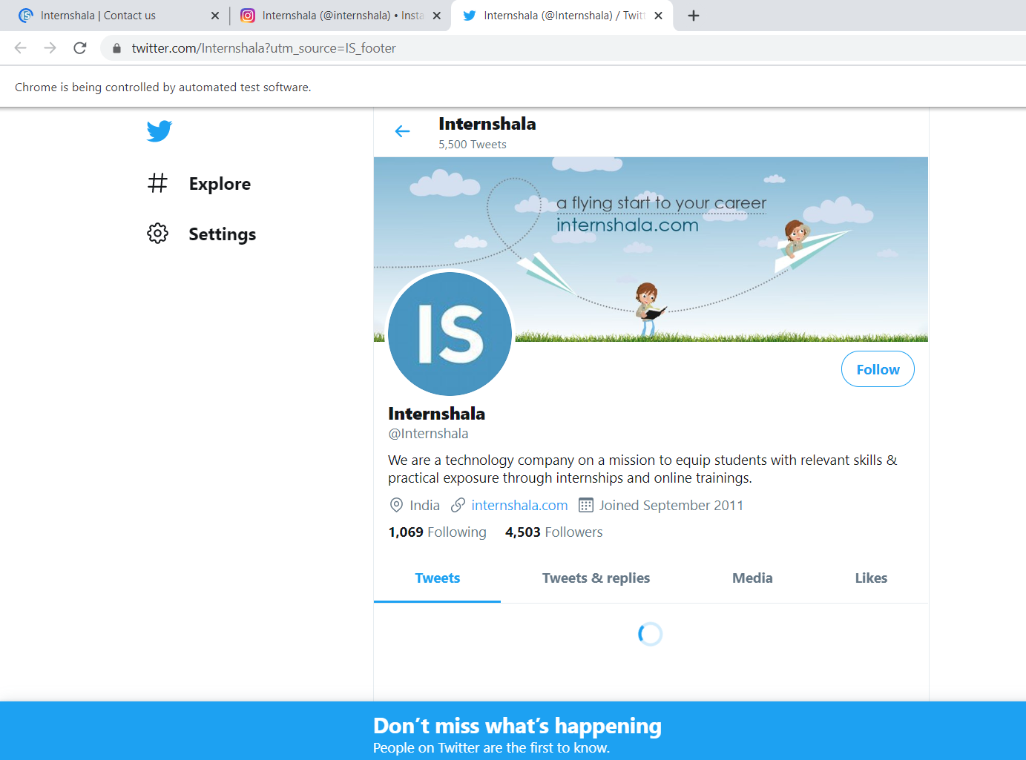
Screenshots

Slide 17
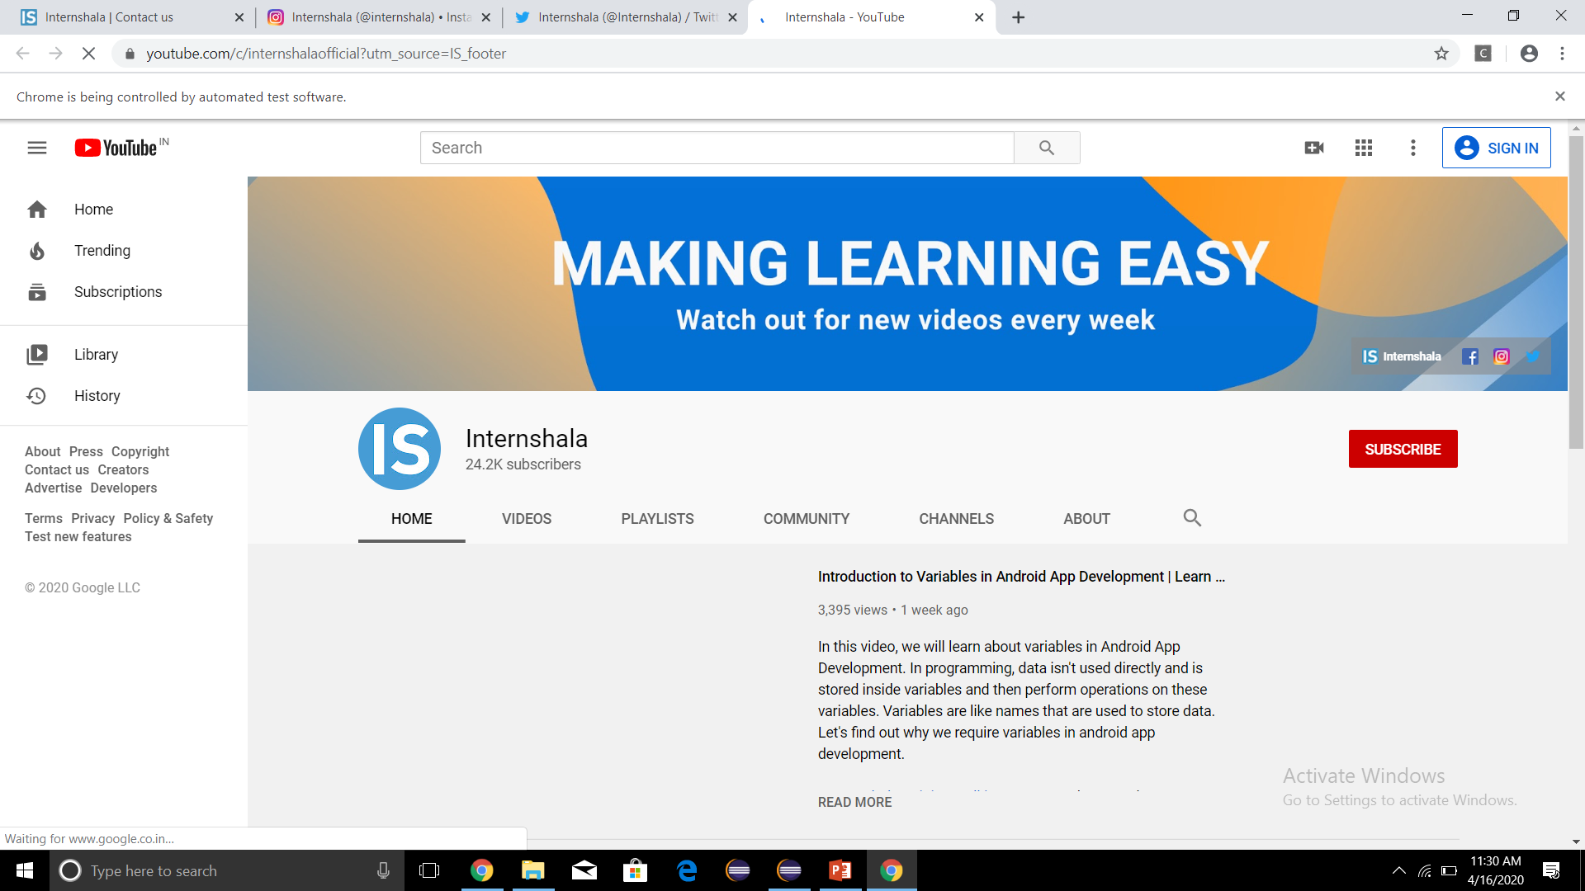
Screenshots

Slide 18
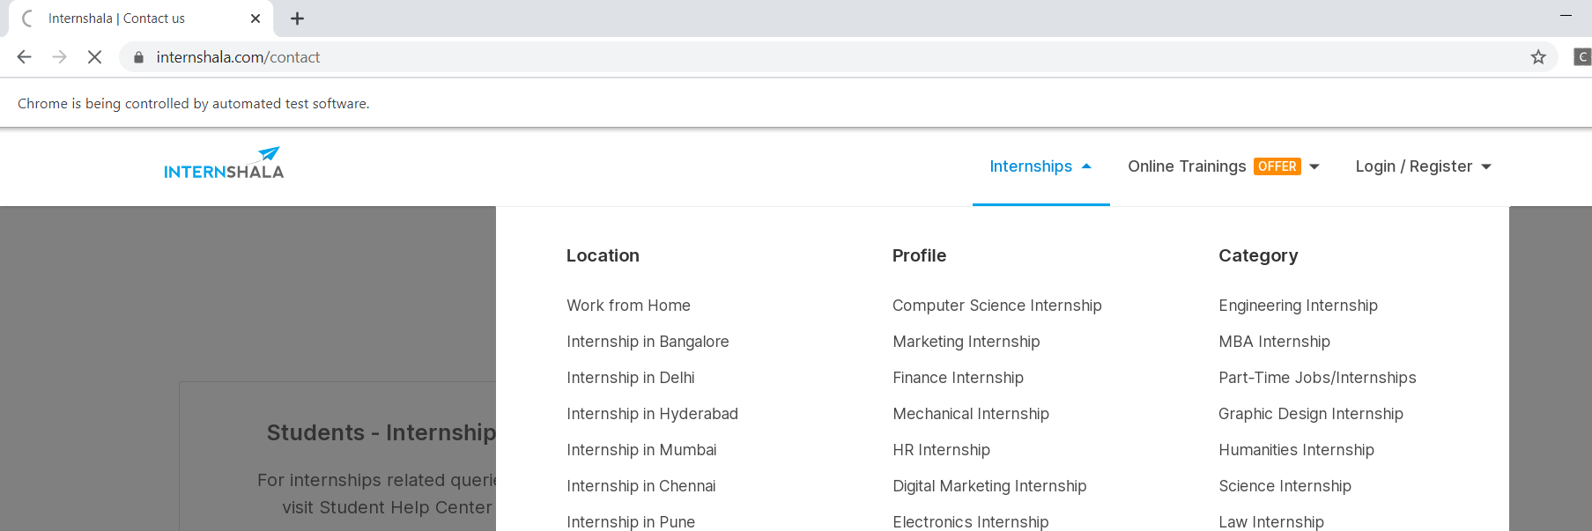
Screenshots

Slide 19
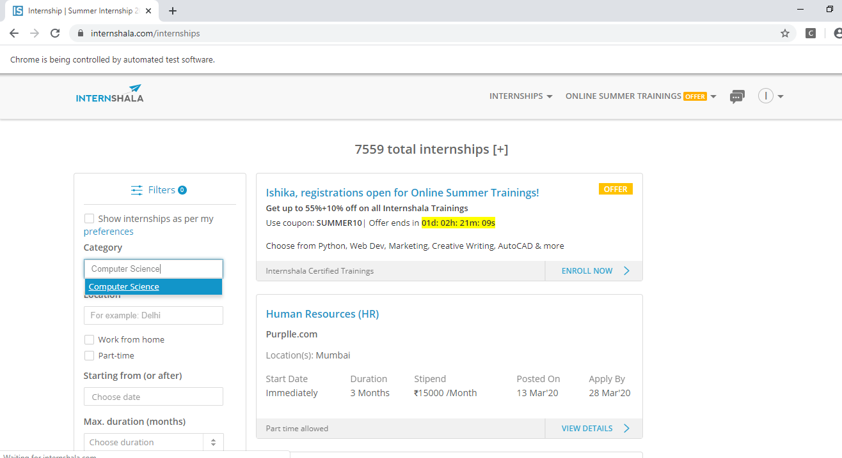
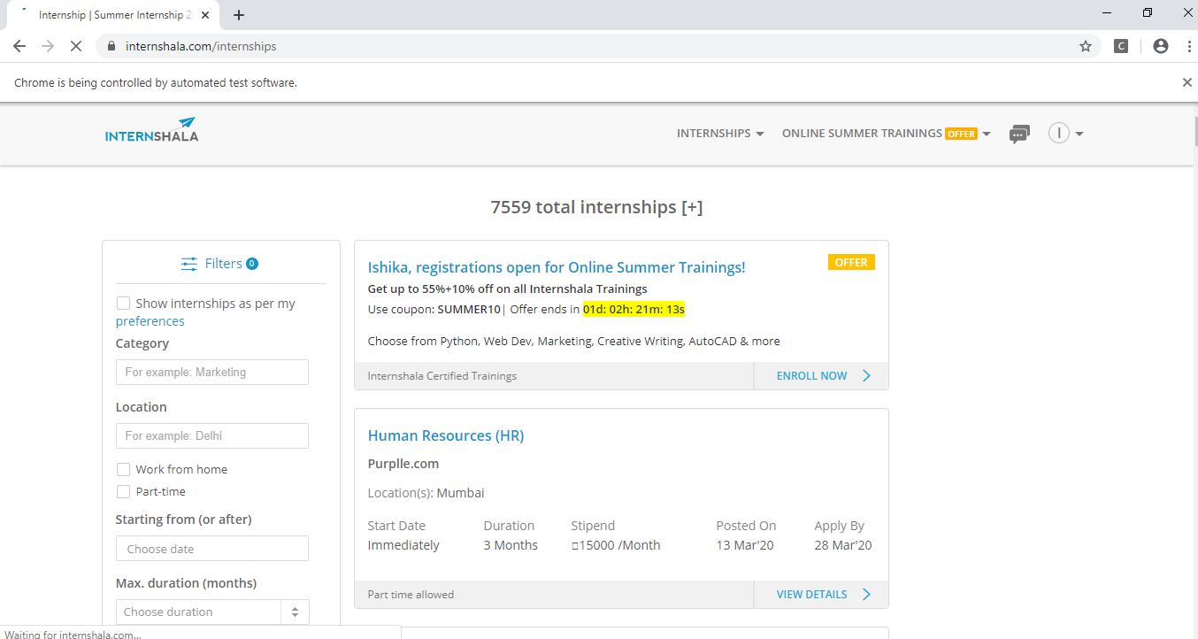
Screenshots

Slide 20
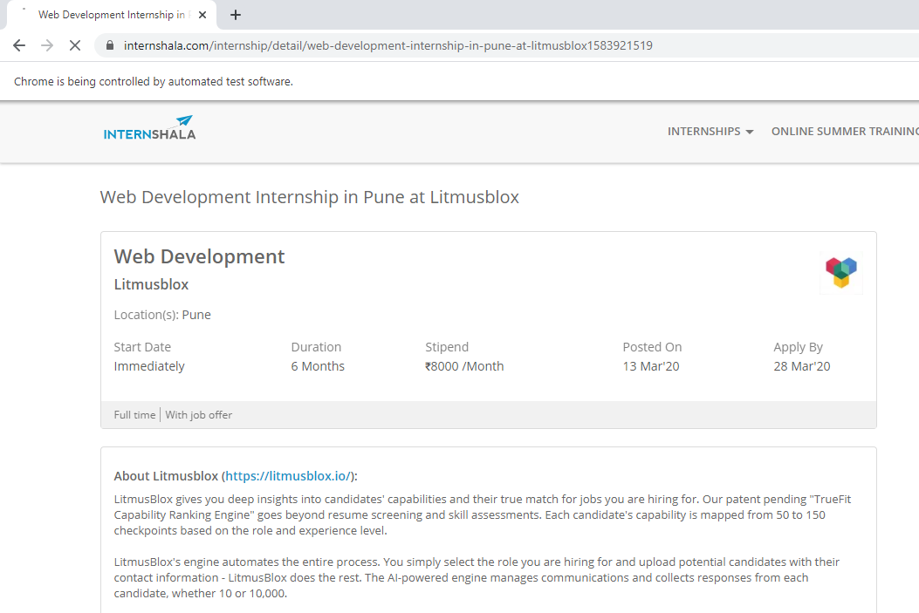
Screenshots

Slide 21
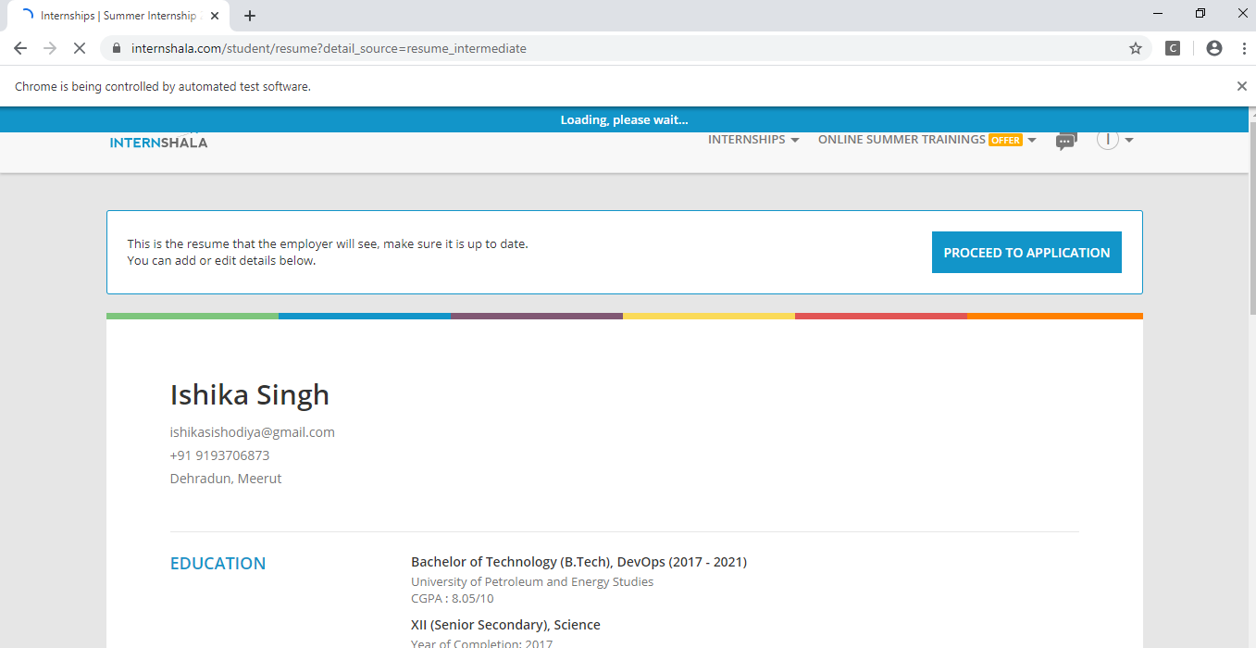
Screenshots

Slide 22
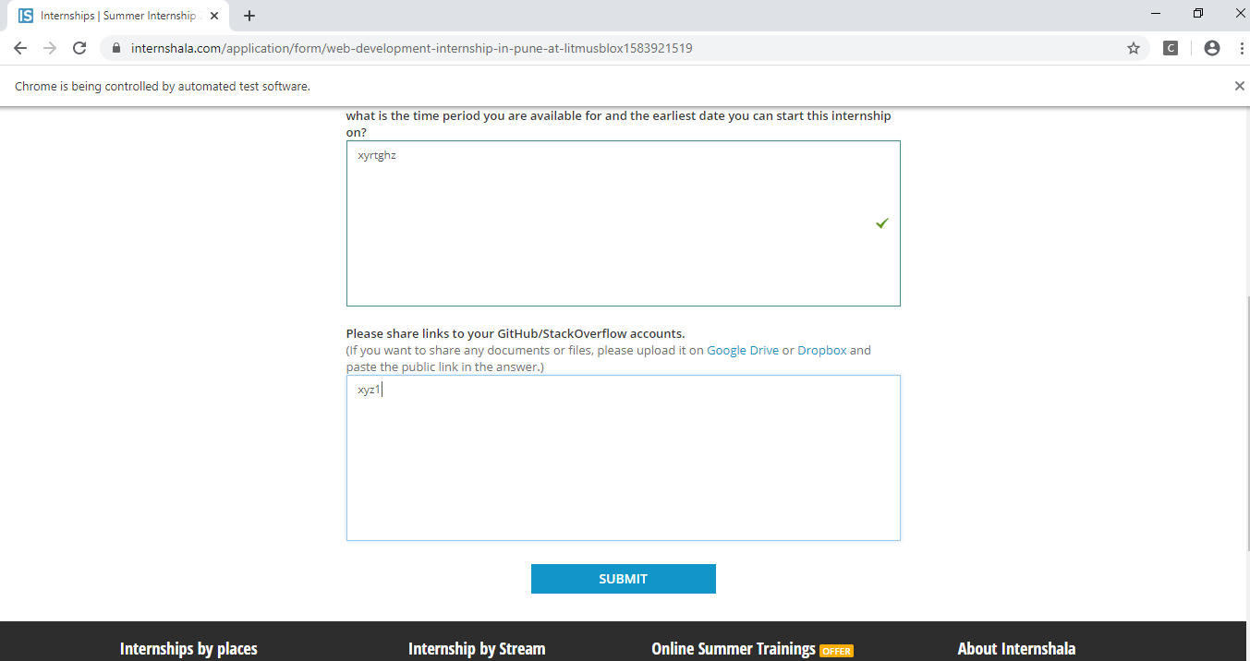
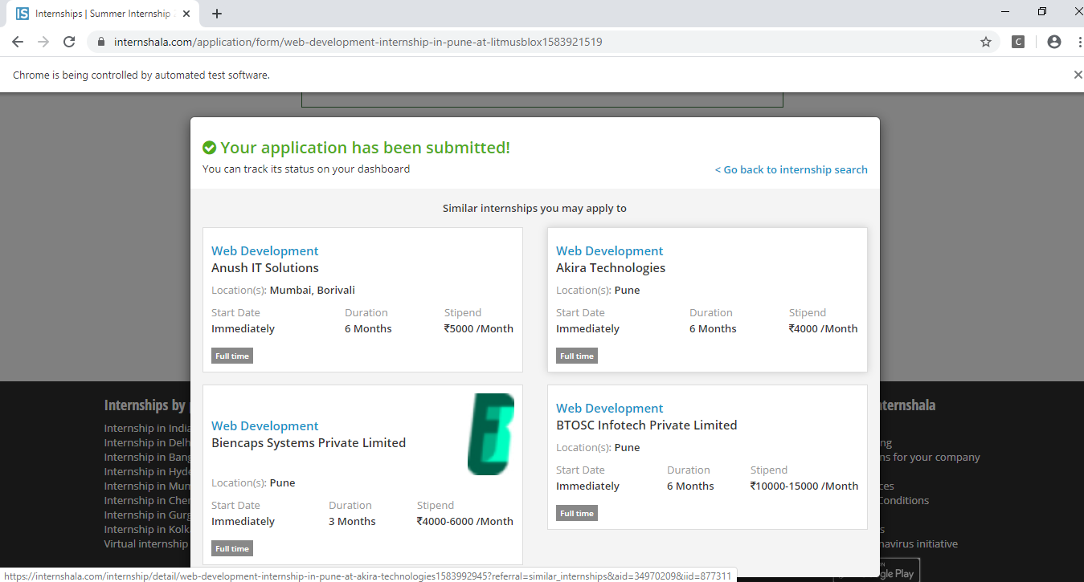
Screenshots

Slide 23
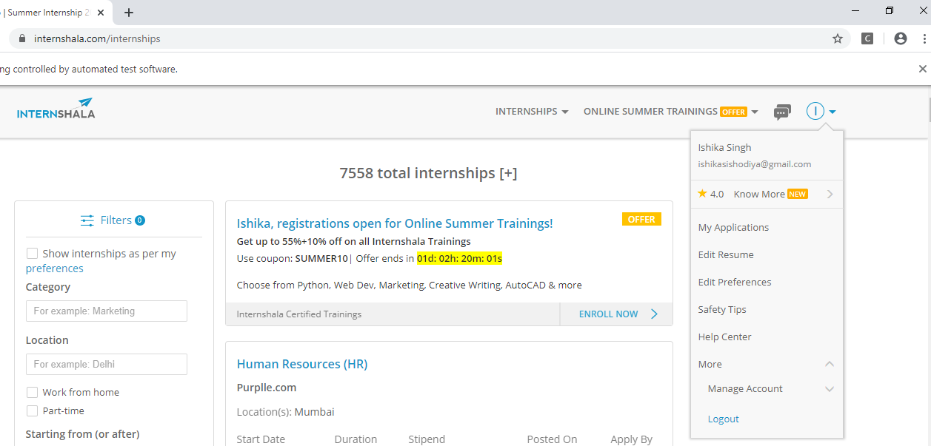
Screenshots
Logout

Slide 24
THANK YOU

